Slide 1

NETWORK SECURITY APPLICATIONS

Slide 2
Kerberos
Kerberos4 is an authentication service
Kerberos provides a centralized authentication server whose function is to authenticate users to servers and servers to users.
Kerberos relies exclusively on symmetric encryption
Two versions of Kerberos are in common use
  Version 4
  Version 5

Slide 3
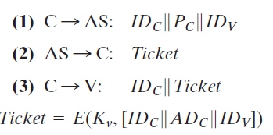
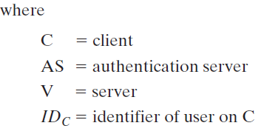
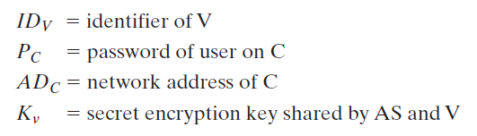
A Simple Authentication Dialogue

Slide 4
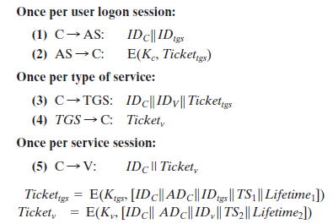
A More Secure Authentication Dialogue
Problems
  Number of times that a user has to enter a password
  Plaintext transmission of the password

Slide 5

Kerberos 4 Overview
Abasic third-party authentication scheme
Have an Authentication Server (AS)
  users initially negotiate with AS to identify self
  AS provides a non-corruptible authentication credential (ticket granting ticket TGT)
Have a Ticket Granting server (TGS)
  users subsequently request access to other services from TGS on basis of users TGT
Notes:
The core of Kerberos is the Authentication and Ticket Granting Servers – these are trusted by all users and servers and must be securely administered.

Slide 6
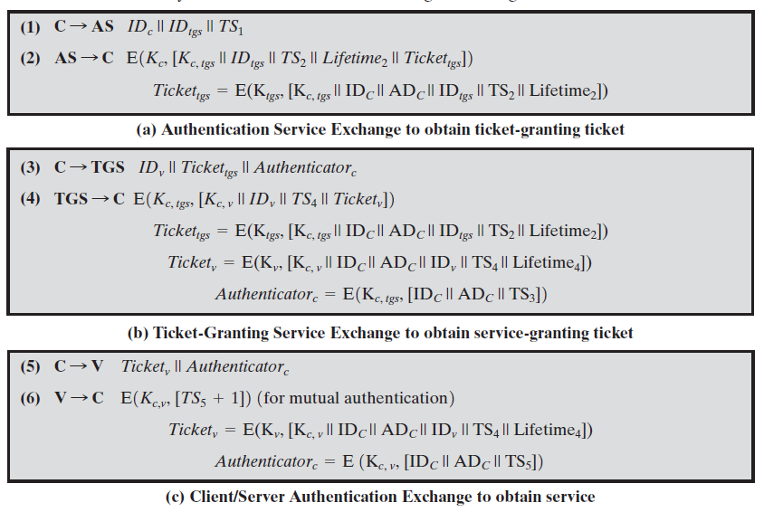
Summary of Kerberos Version 4 Message Exchanges

Slide 7
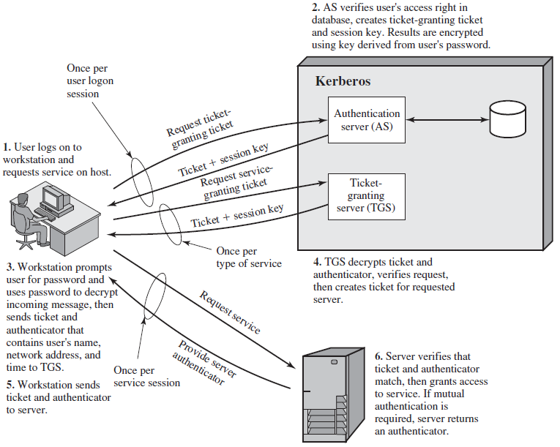
Overview of Kerberos

Slide 8
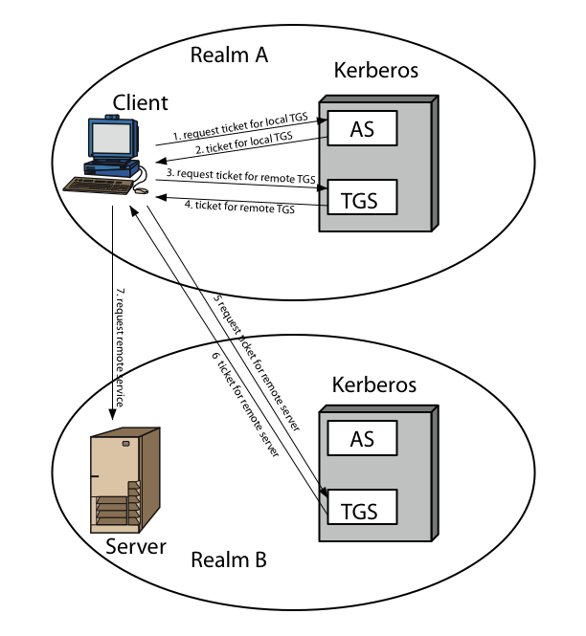
Kerberos Realms
Notes:
Stallings Figure 15.2 shows the authentication messages where service is being requested from another domain. The ticket presented to the remote server indicates the realm in which the user was originally authenticated. The server chooses whether to honor the remote request. One problem presented by the foregoing approach is that it does not scale well to many realms, as each pair of realms need to share a key.

Slide 9
Kerberos Version 5
developed in mid 1990’s
specified as Internet standard RFC 1510
provides improvements over v4
  addresses environmental shortcomings
    encryption alg, network protocol, byte order, ticket lifetime, authentication forwarding, interrealm auth
  and technical deficiencies
    double encryption, non-std mode of use, session keys, password attacks
Notes:
Kerberos Version 5 is specified in RFC 1510 and provides a number of improvements over version 4 in the areas of environmental shortcomings and technical deficiencies, in areas as noted. See Stallings Table 14.3 for details of the Kerberos v5 authentication dialogue.

Slide 10
Environmental shortcomings
Encryption system dependence: Version 4 requires the use of DES concern. In version 5, ciphertext is tagged with an encryption-type identifier so that any encryption technique may be used. Encryption keys are tagged with a type and a length, allowing the same key to be used in different algorithms and allowing the specification of different variations on a given algorithm.
Internet protocol dependence: Version 4 requires the use of Internet Protocol (IP) addresses. Other address types, such as the ISO network address, are not accommodated.Version 5 network addresses are tagged with type and length, allowing any network address type to be used.

Slide 11
Message byte ordering: In version 4, the sender of a message employs a byte ordering of its own choosing and tags the message to indicate least significant byte in lowest address or most significant byte in lowest address. This techniques works but does not follow established conventions. In version 5, all message structures are defined using Abstract Syntax Notation One (ASN.1) and Basic Encoding Rules (BER), which provide an unambiguous byte ordering.
Ticket lifetime: Lifetime values in version 4 are encoded in an 8-bit quantity in units of five minutes. Thus, the maximum lifetime that can be expressed is 2⁸ * 5 = 1280 minutes (a little over 21 hours). This may be inadequate for some applications (e.g., a long-running simulation that requires valid Kerberos credentials throughout execution). In version 5, tickets include an explicit start time and end time, allowing tickets with arbitrary lifetimes.

Slide 12
. Authentication forwarding: Version 4 does not allow credentials issued to one client to be forwarded to some other host and used by some other client. This capability would enable a client to access a server and have that server access another server on behalf of the client. For example, a client issues a request to a print server that then accesses the client’s file from a file server, using the client’s credentials for access. Version 5 provides this capability.
6. Interrealm authentication: In version 4, interoperability among N realms requires on the order of N² Kerberos-to-Kerberos relationships. Version 5 supports a method that requires fewer relationships.

Slide 13
Technical deficiencies
Double encryption: Tickets provided to clients are encrypted twice—once with the secret key of the target server and then again with a secret key known to the client. The second encryption is not necessary and is computationally wasteful.
2. PCBC encryption: Encryption in version 4 makes use of a nonstandard mode of DES known as propagating cipher block chaining (PCBC). It has been demonstrated that this mode is vulnerable to an attack involving the interchange of ciphertext blocks . PCBC was intended to provide an integrity check as part of the encryption operation. Version 5 provides explicit integrity mechanisms, allowing the standard CBC mode to be used for encryption. In particular, a checksum or hash code is attached to the message prior to encryption using CBC.

Slide 14
3. Session keys: Each ticket includes a session key that is used by the client to encrypt the authenticator sent to the service associated with that ticket. In addition, the session key may subsequently be used by the client and the server to protect messages passed during that session. However, because the same ticket may be used repeatedly to gain service from a particular server, there is the risk that an opponent will replay messages from an old session to the client or the server. In version 5, it is possible for a client and server to negotiate a subsession key, which is to be used only for that one connection. A new access by the client would result in the use of a new subsession key.
4. Password attacks: Both versions are vulnerable to a password attack. The message from the AS to the client includes material encrypted with a key based on the client’s password.10 An opponent can capture this message and attempt to decrypt it by trying various passwords. If the result of a test decryption is of the proper form, then the opponent has discovered the client’s password and may subsequently use it to gain authentication credentials from Version 5 does provide a mechanism known as pre-authentication, which should make password attacks more difficult, but it does not prevent them.

Slide 15
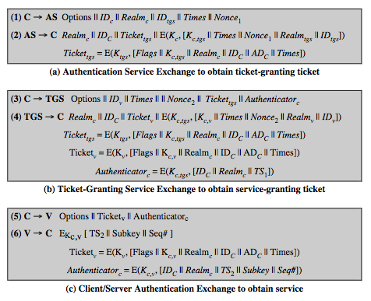
Kerberos v5 Dialogue
Notes:
The basic Kerberos version 5 authentication dialogue is shown here from Stallings Table 15.3. First, consider the authentication service exchange.
Message (1) is a client request for a ticket-granting ticket.
Message (2) returns a ticket-granting ticket, identifying information for the client, and a block encrypted using the encryption key based on the user's password. This block includes the session key to be used between the client and the TGS.
Now compare the ticket-granting service exchange for versions 4 and 5. See that message (3) for both versions includes an authenticator, a ticket, and the name of the requested service. In addition, version 5 includes requested times and options for the ticket and a nonce, all with functions similar to those of message (1). The authenticator itself is essentially the same as the one used in version 4. Message (4) has the same structure as message (2), returning a ticket plus information needed by the client, the latter encrypted with the session key now shared by the client and the TGS. Finally, for the client/server authentication exchange, several new features appear in version 5, such as a request for mutual authentication. If required, the server responds with message (6) that includes the timestamp from the authenticator. The flags field included in tickets in version 5 supports expanded functionality compared to that available in version 4. Stallings Table 15.4 summarizes the flags that may be included in a ticket., with discussion of details in the text.

Slide 16
X.509 Authentication Service
X.509 defines a framework for the provision of authentication services by the X.500 directory to its users.
The directory may serve as a repository of public-key certificates
Each certificate contains the public key of a user and is signed with the private key of a trusted certification authority.
In addition, X.509 defines alternative authentication protocols based on the use of public-key certificates.
X.509 is based on the use of public-key cryptography and digital signatures

Slide 17
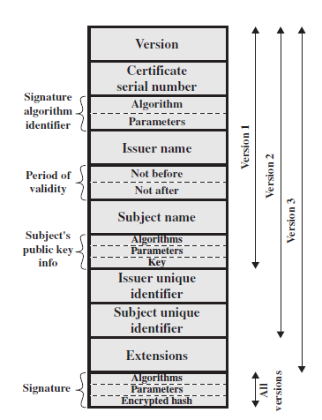
X.509 Certificate
Version: Differentiates among successive versions of the certificate format; the default is version 1.
Serial number: An integer value unique within the issuing CA
Signature algorithm identifier: The algorithm used to sign the certificate
Issuer name: X.500 is the name of the CA
Period of validity: Consists of two dates: the first and last on which the certificate is valid
Subject name: The name of the user to whom this certificate refers.
Subject’s public-key information: The public key of the subject, plus an identifier of the algorithm for which this key is to be used
Issuer unique identifier: Identify uniquely the issuing CA
Subject unique identifier: Identify uniquely the subject in the event
Extensions: A set of one or more extension fields.
Signature: Covers all of the other fields of the certificate

Slide 18

X.509 Version 3
Has been recognised that additional information is needed in a certificate
  email/URL, policy details, usage constraints
Rather than explicitly naming new fields defined a general extension method
Extensions consist of:
  extension identifier
  criticality indicator
  extension value

Slide 19
Obtaining a Certificate
Any user with access to CA can get any certificate from it
Only the CA can modify a certificate
Because cannot be forged, certificates can be placed in a public directory

Slide 20
CA Hierarchy
If both users share a common CA then they are assumed to know its public key
Otherwise CA's must form a hierarchy
Use certificates linking members of hierarchy to validate other CA's
  each CA has certificates for clients (forward) and parent (backward)
Each client trusts parents certificates
Enable verification of any certificate from one CA by users of all other CAs in hierarchy
Notes:
All very easy is both parties use the same CA. If not, then there has to be some means to form a chain of certifications between the CA's used by the two parties. And that raises issues about whether the CA's are equivalent, whether they used the same policies to generate their certificates, and how much you're going to trust a CA at some remove from your own. These are all open issues.

Slide 21
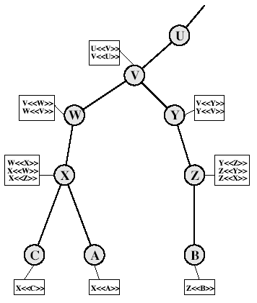
CA Hierarchy Use
Notes:
Stallings Fig 14.4.
Track chains of certificates:
A acquires B certificate using chain: X<<W>>W<<V>>V<<Y>>Y<<Z>>Z<<B>>
B acquires A certificate using chain: Z<<Y>>Y<<V>>V<<W>>W<<X>>X<<A>>

Slide 22
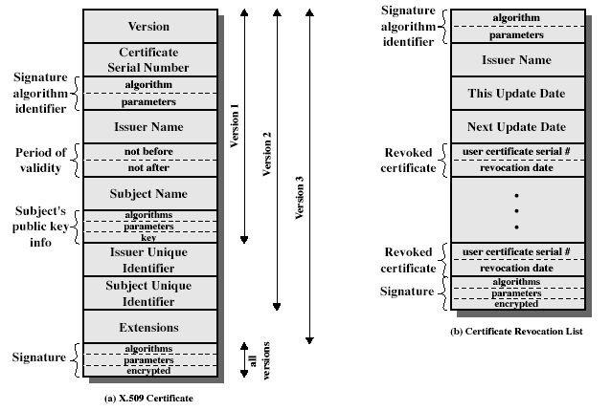
Certificate Revocation
Certificates have a period of validity
May need to revoke before expiry, eg:
  user's private key is compromised
  user is no longer certified by this CA
  CA's certificate is compromised
CA’s maintain list of revoked certificates
  the Certificate Revocation List (CRL)
Users should check certs with CA’s CRL

Slide 23
Certificate Extensions
Key and policy information
  convey info about subject & issuer keys, plus indicators of certificate policy
Certificate subject and issuer attributes
  support alternative names, in alternative formats for certificate subject and/or issuer
Certificate path constraints
  allow constraints on use of certificates by other CA’s

Slide 24
Public Key Infrastructure
Public-key infrastructure (PKI) defined as the set of hardware, software, people, policies, and procedures needed to create, manage, store, distribute, and revoke digital certificates based on asymmetric cryptography.
The principal objective for developing a PKI is to enable secure, convenient, and efficient acquisition of public keys
Public Key Infrastructure X.509 (PKIX) working group has been the driving force behind setting up a formal (and generic) model based on X.509 that is suitable for deploying a certificate-based architecture on the Internet

Slide 25
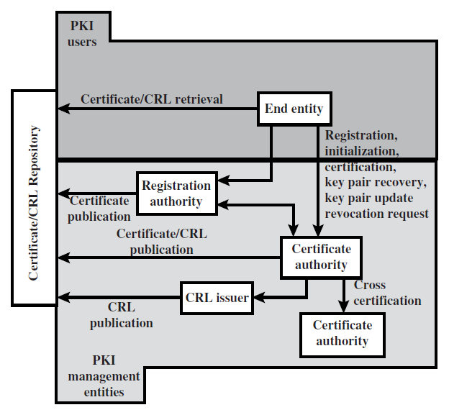
PKIX Architectural Model
public-key infrastructure (PKI) is defined as the set of hardware, software, people, policies, and procedures needed to create, manage, store, distribute, and revoke digital certificates based on asymmetric cryptography. Its principal is to enable secure, convenient, and efficient acquisition of public keys.

Slide 26
Key elements of the PKIX model
End entity: A generic term used to denote end users, devices (e.g., servers, routers), or any other entity that can be identified in the subject field of a public key certificate.
Certification authority (CA): The issuer of certificates and (usually) certificate revocation lists (CRLs). It may also support a variety of administrative functions, although these are often delegated to one or more Registration Authorities.
Registration authority (RA): An optional component that can assume a number of administrative functions from the CA. The RA is often associated with the end entity registration process but can assist in a number of other areas as well.
CRL issuer: An optional component that a CA can delegate to publish CRLs.
Repository: A generic term used to denote any method for storing certificates and CRLs so that they can be retrieved by end entities.

Slide 27
PKIX Management Functions
Registration: whereby a user first makes itself known to a CA, prior to issue of a certificate(s) for that user. It usually involves some off-line or online procedure for mutual authentication.
Initialization: to install key materials that have the appropriate relationship with keys stored elsewhere in the infrastructure.
Certification: process where a CA issues a certificate for a user's public key, and returns it to the user's client system and/or posts it in a repository.
Key pair recovery: a mechanism to recover the necessary decryption keys when normal access to the keying material is no longer possible.
Key pair update: key pairs need to be updated and new certificates issued.
Revocation request: when authorized person advises need for certificate revocation, e.g. private key compromise, affiliation change, name change.
Cross certification: when two CAs exchange information used in establishing a cross-certificate, issued by one CA to another CA that contains a CA signature key used for issuing certificates.
Notes:
PKIX identifies a number of management functions that potentially need to be supported by management protocols, as shown in Figure 14.16:
• Registration: whereby a user first makes itself known to a CA, prior to issue of a certificate(s) for that user. It usually involves some off-line or online procedure for mutual authentication.
• Initialization: to install key materials that have the appropriate relationship with keys stored elsewhere in the infrastructure.
• Certification: process where a CA issues a certificate for a user's public key, and returns it to the user's client system and/or posts it in a repository.
• Key pair recovery: a mechanism to recover the necessary decryption keys when normal access to the keying material is no longer possible.
• Key pair update: key pairs need to be updated and new certificates issued.
• Revocation request: when authorized person advises need for certificate revocation, e.g. private key compromise, affiliation change, name change.
• Cross certification: when two CAs exchange information used in establishing a cross-certificate, issued by one CA to another CA that contains a CA signature key used for issuing certificates.
The PKIX working group has defines two alternative management protocols between PKIX entities. RFC 2510 defines the certificate management protocols (CMP), which is a flexible protocol able to accommodate a variety of technical, operational, and business models. RFC 2797 defines certificate management messages over CMS (RFC 2630) called CMC. This is built on earlier work to leverage existing code.

Slide 28
IP Security
Security at IP level, ensures secure networking for all applications
IP level security encompasses three functional areas:
Authentication, confidentiality and Key management
Applications of Ipsec
  Secure branch office connectivity over the Internet
  Secure remote access over the Internet
  Establishing extranet and intranet connectivity with partners
  Enhancing electronic commerce security

Slide 29
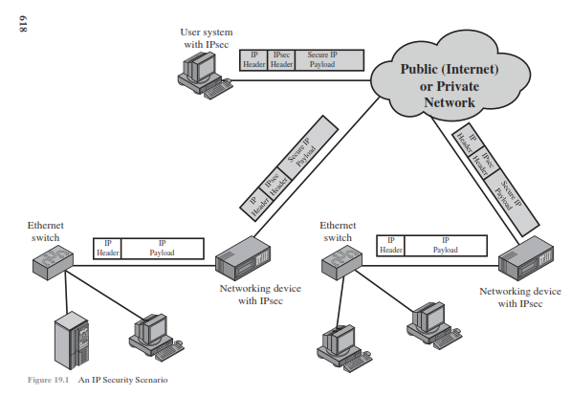
IPSec Scenario

Slide 30
Benefits of IPsec
When IPsec is implemented in a firewall or router, it provides strong security that can be applied to all traffic crossing the perimeter.
IPsec in a firewall is resistant to bypass if all traffic from the outside must use IP and the firewall is the only means of entrance from the Internet into the organization.
IPsec is below the transport layer (TCP, UDP) and so is transparent to applications.
IPsec can be transparent to end users.
IPsec can provide security for individual users if needed.

Slide 31
IPsec Documents
Architecture: Covers the general concepts, security requirements, definitions, and mechanisms defining IPsec technology.
Authentication Header (AH): AH is an extension header to provide message authentication.
Encapsulating Security Payload (ESP): ESP consists of an encapsulating header and trailer used to provide encryption or combined encryption/authentication.
Internet Key Exchange (IKE): This is a collection of documents describing the key management schemes for use with IPsec.
Cryptographic algorithms: This category encompasses a large set of documents that define and describe cryptographic algorithms for encryption, message authentication, pseudorandom functions (PRFs), and cryptographic key exchange.
Other: There are a variety of other IPsec-related RFCs, including those dealing with security policy and management information base (MIB) content.

Slide 32
IPsec Services
Access control : Prevention of unauthorized use of a resource.
Connectionless integrity : Assurance that received traffic has not been modified. Integrity includes anti-reply defenses.
Data origin authentication : Assurance that traffic is sent by legitimate party or parties.
Rejection of replayed packets (a form of partial sequence integrity)
Confidentiality (encryption) : Assurance that user’s traffic is not examined by non-authorized parties.
Limited traffic flow confidentiality

Slide 33
Security Associations (SA)
A one way relationsship between a sender and a receiver.
Identified by three parameters:
  Security Parameter Index (SPI): A bit string assigned to this SA and having loca significance only.
  IP Destination address: A destination address of the endpoiint of the SA.
  Security Protocol Identifier: Indicates whether the association is AH or ESP
http://sce.uhcl.edu/yang/teaching/....../IPsecurity.ppt

Slide 34
Transport and Tunnel Modes
Transport mode
  Transport mode provides protection primarily for upper-layer protocols. That is, transport mode protection extends to the payload of an IP packet
Tunnel mode
  Tunnel mode provides protection to the entire IP packet.
  To achieve this, after the AH or ESP fields are added to the IP packet, the entire packet plus security fields is treated as the payload of new outer IP packet with a new outer IP header.
  The entire original, inner, packet travels through a tunnel from one point of an IP network to another; no routers along the way are able to examine the inner IP header.

Slide 35
Transport and Tunnel Modes
Transport Mode
  to encrypt & optionally authenticate IP data
  can do traffic analysis but is efficient
  good for ESP host to host traffic
Tunnel Mode
  encrypts entire IP packet
  add new header for next hop
  no routers on way can examine inner IP header
  good for VPNs, gateway to gateway security

Slide 36
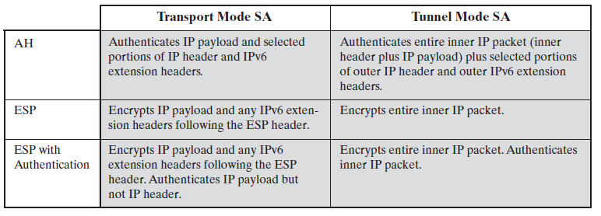
Tunnel mode and Transport mode functionality

Slide 37
Authentication Header (AH)
provides support for data integrity & authentication of IP packets
  end system/router can authenticate user/app
  prevents address spoofing attacks by tracking sequence numbers
based on use of a MAC
  HMAC-MD5-96 or HMAC-SHA-1-96
parties must share a secret key

Slide 38
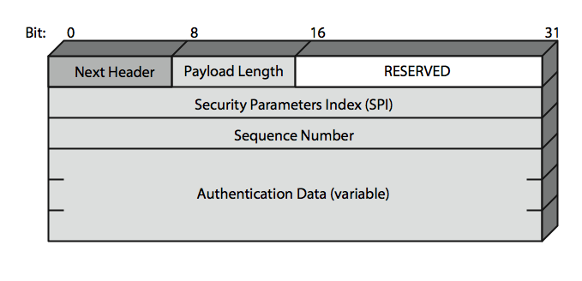
Authentication Header (AH)

Slide 39
Authentication Header (AH)
Next Header (8 bits): Identifies the type of header immediately following this header
Payload Length (8 bits): Length of Authentication Header in 32-bit words, minus 2.
Reserved (16 bits): For future use
Security Parameters Index (32 bits): Identifies a security association
Sequence Number (32 bits): A monotonically increasing counter value
Authentication Data (variable): A variable-length field (must be an integral number of 32-bit words) that contains the Integrity Check Value (ICV), or MAC, for this packet

Slide 40
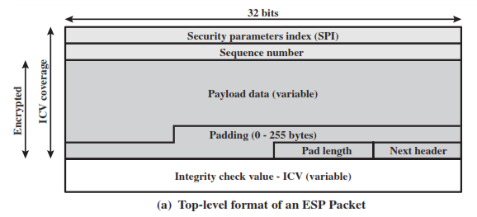
Encapsulating Security Payload
ESP consists of an encapsulating header and trailer used to provide encryption or combined encryption/authentication.

Slide 41
ESP packet fields
Security Parameters Index (32 bits): Identifies a security association.
Sequence Number (32 bits): A monotonically increasing counter value; this provides an anti-replay function, as discussed for AH.
Payload Data (variable): This is a transport-level segment (transport mode) or IP packet (tunnel mode) that is protected by encryption.
Padding (0 – 255 bytes): The purpose of this field is discussed later.
Pad Length (8 bits): Indicates the number of pad bytes immediately preceding this field.
Next Header (8 bits): Identifies the type of data contained in the payload data field by identifying the first header in that payload (for example, an extension header in IPv6, or an upper-layer protocol such as TCP).
Integrity Check Value (variable): A variable-length field (must be an integral number of 32-bit words) that contains the Integrity Check

Slide 42
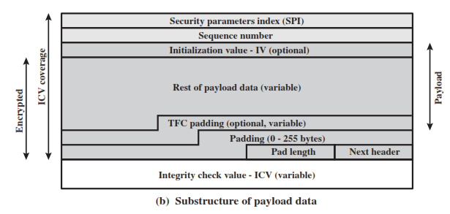
Encapsulating Security Payload

Slide 43
Transport vs Tunnel Mode ESP
transport mode is used to encrypt & optionally authenticate IP data
  data protected but header left in clear
  can do traffic analysis but is efficient
  good for ESP host to host traffic
tunnel mode encrypts entire IP packet
  add new header for next hop
  good for VPNs, gateway to gateway security

Slide 44
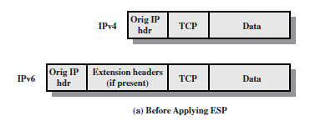
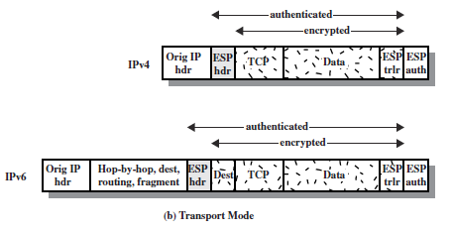
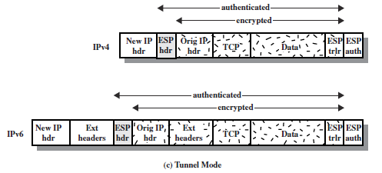

Slide 45
Combining Security Associations
SA’s can implement either AH or ESP
to implement both need to combine SA’s
  form a security association bundle
  may terminate at different or same endpoints
  combined by
    transport adjacency
    iterated tunneling
combining authentication & encryption
  ESP with authentication, bundled inner ESP & outer AH, bundled inner transport & outer ESP

Slide 46
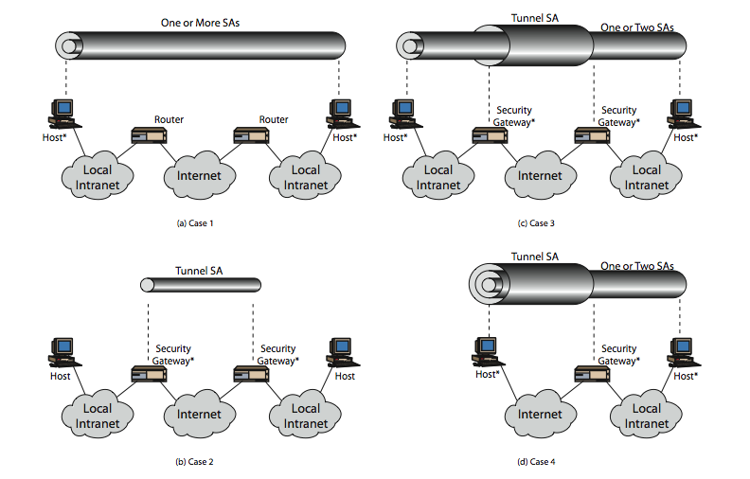
Combining Security Associations

Slide 47
IPSec Key Management
handles key generation & distribution
typically need 2 pairs of keys
  2 per direction for AH & ESP
manual key management
  sysadmin manually configures every system
automated key management
  automated system for on demand creation of keys for SA’s in large systems
  has Oakley & ISAKMP elements

Slide 48
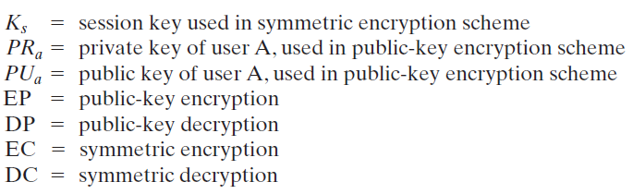
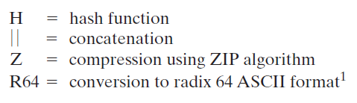
PGP
PGP provides a confidentiality and authentication service that can be used for electronic mail and file storage applications

Slide 49
Operational Description of PGP
The actual operation of PGP, as opposed to the management of keys, consists of four services:
  authentication,
  confidentiality,
  compression, and
  e-mail compatibility

Slide 50
PGP AUTHENTICATION
The sender creates a message.
SHA-1 is used to generate a 160-bit hash code of the message.
The hash code is encrypted with RSA using the sender’s private key, and the result is prepended to the message.
The receiver uses RSA with the sender’s public key to decrypt and recover the hash code.
The receiver generates a new hash code for the message and compares it with the decrypted hash code. If the two match, the message is accepted as authentic.

Slide 51
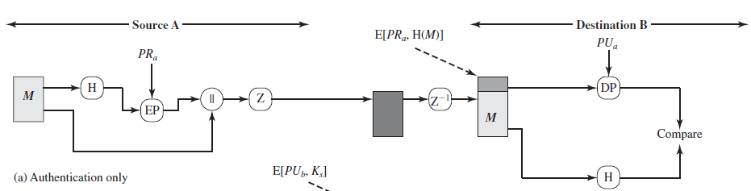
PGP AUTHENTICATION

Slide 52
PGP CONFIDENTIALITY
The sender generates a message and a random 128-bit number to be used as a session key for this message only.
The message is encrypted using CAST-128 (or IDEA or 3DES) with the session key.
The session key is encrypted with RSA using the recipient’s public key and is prepended to the message.
The receiver uses RSA with its private key to decrypt and recover the session key.
The session key is used to decrypt the message.

Slide 53
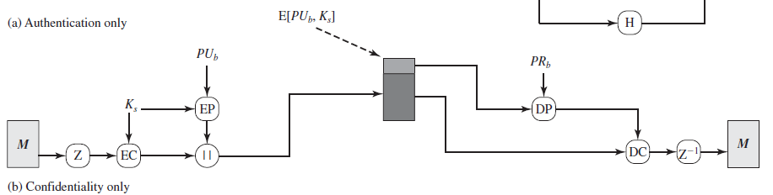
PGP CONFIDENTIALITY

Slide 54
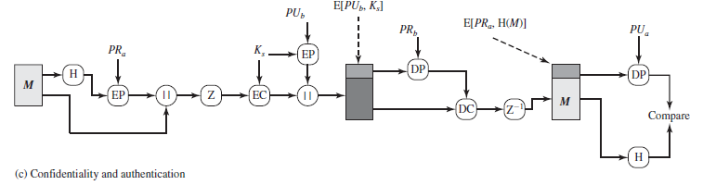
PGP CONFIDENTIALITY & AUTHENTICATION

Slide 55
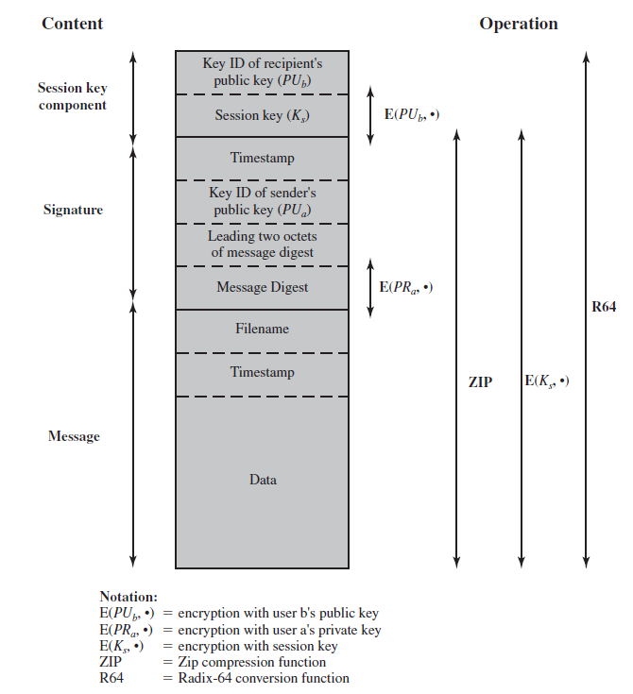
PGP Message

Slide 56
PGP Message
A message consists of three components:
  the message component,
  a signature (optional), and
  a session key component (optional).
The message component includes the actual data to be stored or transmitted, as well as a filename and a timestamp that specifies the time of creation.
The signature component includes the following.
  Timestamp: The time at which the signature was made.
  Message digest: The 160-bit SHA-1 digest encrypted with the sender’s private signature key.
  Leading two octets of message digest: Enables the recipient to determine if the correct public key was used to decrypt the message digest for authentication by comparing this plaintext copy of the first two octets with the first two octets of the decrypted digest.
  Key ID of sender’s public key: Identifies the public key that should be used to decrypt the message digest
The session key component includes the session key and the identifier of the recipient’s public key that was used by the sender to encrypt the session key.

Slide 57
PGP Session Keys
need a session key for each message
  of varying sizes: 56-bit DES, 128-bit CAST or IDEA, 168-bit Triple-DES
uses random inputs taken from previous uses and from keystroke timing of user

Slide 58
PGP Key Rings
each PGP user has a pair of keyrings:
  public-key ring contains all the public-keys of other PGP users known to this user, indexed by key ID
  private-key ring contains the public/private key pair(s) for this user, indexed by key ID & encrypted keyed from a hashed passphrase

Slide 59
PGP Key Management
rather than relying on certificate authorities
in PGP every user is own CA
  can sign keys for users they know directly
forms a “web of trust”

Slide 60
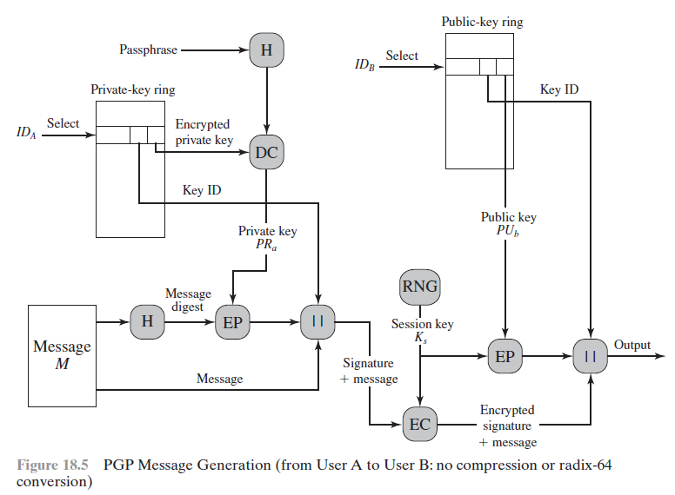
PGP Message Generation

Slide 61
PGP Message Generation
1. Signing the message:
  a. PGP retrieves the sender’s private key from the private-key ring using your_userid as an index. If your_userid was not provided in the command, the first private key on the ring is retrieved.
  b. PGP prompts the user for the passphrase to recover the unencrypted private key.
  c. The signature component of the message is constructed.
2. Encrypting the message:
  a. PGP generates a session key and encrypts the message.
  b. PGP retrieves the recipient’s public key from the public-key ring using her_userid as an index.
  c. The session key component of the message is constructed.

Slide 62
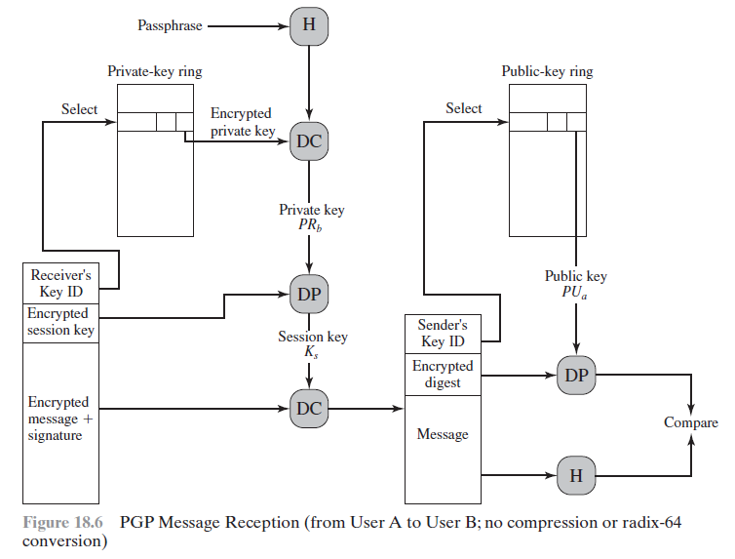
PGP Message Reception

Slide 63
PGP Message Reception
1. Decrypting the message:
  a. PGP retrieves the receiver’s private key from the private-key ring using the Key ID field in the session key component of the message as an index.
  b. PGP prompts the user for the passphrase to recover the unencrypted private key.
  c. PGP then recovers the session key and decrypts the message.
2. Authenticating the message:
  a. PGP retrieves the sender’s public key from the public-key ring using the Key ID field in the signature key component of the message as an index.
  b. PGP recovers the transmitted message digest.
  c. PGP computes the message digest for the received message and compares it to the transmitted message digest to authenticate.

Slide 64
MIME
Multipurpose Internet Mail Extensions (MIME) is an Internet standard that extends the format of email to support:
  Text in character sets other than ASCII
  Non-text attachments: audio, video, images, application programs etc.
  Message bodies with multiple parts
  Header information in non-ASCII character sets

Slide 65
S/MIME
Secure/Multipurpose Internet Mail Extension (S/MIME) is a security enhancement to the MIME Internet e-mail format standard based on technology from RSA Data Security.
Multipurpose Internet Mail Extension (MIME is intended to address some of the problems and limitations of the use of Simple Mail Transfer Protocol (SMTP)
  SMTP cannot transmit executable files or other binary objects.
  SMTP cannot transmit text data that includes national language characters
  SMTP servers may reject mail message over a certain size.
  SMTP gateways that translate between ASCII and the character code EBCDIC do not use a consistent set of mappings, resulting in translation problems.

Slide 66
  SMTP gateways to X.400 electronic mail networks cannot handle nontextual data included in X.400 messages.
  Some SMTP implementations do not adhere completely to the SMTP standards defined in RFC 821. Common problems include:
      Deletion, addition, or reordering of carriage return and linefeed
      Truncating or wrapping lines longer than 76 characters
      Removal of trailing white space (tab and space characters)
      Padding of lines in a message to the same length
      Conversion of tab characters into multiple space characters

Slide 67
MIME
The MIME specification includes the following elements.
Five new message header fields are defined, which may be included in an RFC 5322 header. These fields provide information about the body of the message.
A number of content formats are defined, thus standardizing representations that support multimedia electronic mail.
Transfer encodings are defined that enable the conversion of any content format into a form that is protected from alteration by the mail system.

Slide 68
Header fields defined in MIME
MIME-Version: Must have the parameter value 1.0. This field indicates that the message conforms to RFCs 2045 and 2046.
Content-Type: Describes the data contained in the body with sufficient detail that the receiving user agent can pick an appropriate agent or mechanism to represent the data to the user or otherwise deal with the data in an appropriate manner.
Content-Transfer-Encoding: Indicates the type of transformation that has been used to represent the body of the message in a way that is acceptable for mail transport.
Content-ID: Used to identify MIME entities uniquely in multiple contexts.
Content-Description: A text description of the object with the body; this is useful when the object is not readable (e.g., audio data).

Slide 69
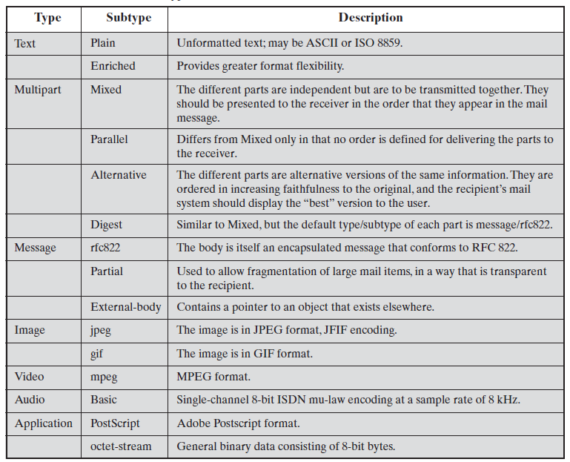
MIME Content Types

Slide 70

MIME – Content types and subtypes
text/plain, text/enriched
image/jpeg, image/gif
video/mpeg
audio/basic
application/postscript, application/octet-stream
multipart/mixed, multipart/parallel, multipart/alternative, multipart/digest (each part is message/rfc822)
message/rfc822, message/partial, message/external-body
S/MIME / introduction

Slide 71
MIME – Transfer encodings
7bit
  short lines of ASCII characters
8bit
  short lines of non-ASCII characters
binary
  non-ASCII characters
  lines are not necessarily short
quoted-printable
  non-ASCII characters are converted into hexa numbers (e.g., =EF)
base64 (radix 64)
  3 8-bit blocks into 4 6-bit blocks
x-token
  non-standard encoding
S/MIME / introduction

Slide 72
MIME – Example
MIME-Version: 1.0
From: Nathaniel Borenstein <nsb@nsb.fv.com>
To: Ned Freed <ned@innosoft.com>
Date: Fri, 07 Oct 1994 16:15:05 -0700 (PDT)
Subject: A multipart example
Content-Type: multipart/mixed; boundary=unique-boundary-1
This is the preamble area of a multipart message. Mail readers that understand multipart format
should ignore this preamble. If you are reading this text, you might want to consider changing to a mail reader
that understands how to properly display multipart messages.
--unique-boundary-1
Content-type: text/plain; charset=US-ASCII
… Some text …
--unique-boundary-1
Content-Type: multipart/parallel; boundary=unique-boundary-2
--unique-boundary-2
Content-Type: audio/basic
Content-Transfer-Encoding: base64
... base64-encoded 8000 Hz single-channel mu-law-format audio data goes here ...
--unique-boundary-2
Content-Type: image/jpeg
Content-Transfer-Encoding: base64
... base64-encoded image data goes here ...
--unique-boundary-2--
S/MIME / introduction

Slide 73
MIME – Example cont’d
--unique-boundary-1
Content-type: text/enriched
This is <bold><italic>enriched.</italic></bold><smaller>as defined in RFC 1896</smaller>
Isn’t it <bigger><bigger>cool?</bigger></bigger>
--unique-boundary-1
Content-Type: message/rfc822
From: (mailbox in US-ASCII)
To: (address in US-ASCII)
Subject: (subject in US-ASCII)
Content-Type: Text/plain; charset=ISO-8859-1
Content-Transfer-Encoding: Quoted-printable
... Additional text in ISO-8859-1 goes here ...
--unique-boundary-1--
S/MIME / introduction

Slide 74
S/MIME services
Enveloped data (application/pkcs7-mime; smime-type = enveloped-data)
  standard digital envelop : Consists of encrypted content of any type and encrypted contents and encryption keys for one or more recipients
Signed data (application/pkcs7-mime; smime-type = signed-data)
  standard digital signature (“hash and sign”)
  content + signature is encoded using base64 encoding
Clear-signed data (multipart/signed)
  standard digital signature
  only the signature is encoded using base64
  recipient without S/MIME capability can read the message but cannot verify the signature
Signed and enveloped data
  signed and encrypted entities may be nested in any order
S/MIME / services

Slide 75
Cryptographic algorithms
must: absolute requirement of the specification
Should: there may exist valid reasons to ignore this feature
Create Message digest
  must: SHA-1, MD5
  should (receiver): SHA1
Encrypt message digest to form Digital signature
  must: DSS, RSA
  should: RSA
Session key encryption
  must: ElGamal , RSA
  should: RSA
Encrypt message for transmission
  sender:
    should: 3DES, RC2/40
  receiver:
    must: 3DES
    should: RC2/40
S/MIME / services

Slide 76
Securing a MIME entity
MIME entity is prepared according to the normal rules for MIME message preparation
Prepared MIME entity is processed by S/MIME to produce a PKCS object
The PKCS object is treated as message content and wrapped in MIME

Slide 77
PKCS7 “signed data”
Version
(Set of) Digest Algorithms
Content type
Content Info
Content
Set of certificates
Version
Set of CRLs
Signer ID (issuer and ser. no.)
Signer Info
Digest Algorithm
Authenticated Attributes
S/MIME / message formats
Digest Encryption Alg.
Encrypted digest (signature)

Slide 78
PKCS7 “enveloped data”
Version
Originator Info
Version
Recipient Info
Recipient ID (issuer and s.no.)
Key Encryption Algorithm
Encrypted Content Info
Encrypted Key
Content type
Content Encryption Alg.
Encrypted Content
S/MIME / message formats

Slide 79
Enveloped data – Example
Content-Type: application/pkcs7-mime; smime-type=enveloped-data; name=smime.p7m
Content-Transfer-Encoding: base64
Content-Disposition: attachment; filename=smime.p7m
rfvbnj756tbBghyHhHUujhJhjH77n8HHGT9HG4VQpfyF467GhIGfHfYT6
7n8HHGghyHhHUujhJh4VQpfyF467GhIGfHfYGTrfvbnjT6jH7756tbB9H
f8HHGTrfvhJhjH776tbB9HG4VQbnj7567GhIGfHfYT6ghyHhHUujpfyF4
0GhIGfHfQbnj756YT64V
S/MIME / message formats

